Slide 1

LinkedIn Crawler:
The User Interface
Backlog & Conceptual Model
Team 10:
Kevin Seveur
Spencer Bryant
Leah Jean-Francois
Anthony Lieu
Kevin La

Slide 2
The LinkedIn Crawler: The Holistic View
The LinkedIn Crawler is a collaboration project between three teams
The goal is to create an application that GSU students can use to locate current and former GSU students using several different search criteria
LinkedIn.com will be the repository with which we extract query results from
The output of the application will be a csv document which will contain the search results

Slide 3
The LinkedIn Crawler: The User Interface
Our team is tasked with creating the user experience for the application
We will create a desktop application utilizing JavaFX for the view component. The resulting JavaFX code is in an FXML format.
Our main controller will be done using the Java language
CSS will be used to implement styling of the user interface
The version control system used will be GIT

Slide 4
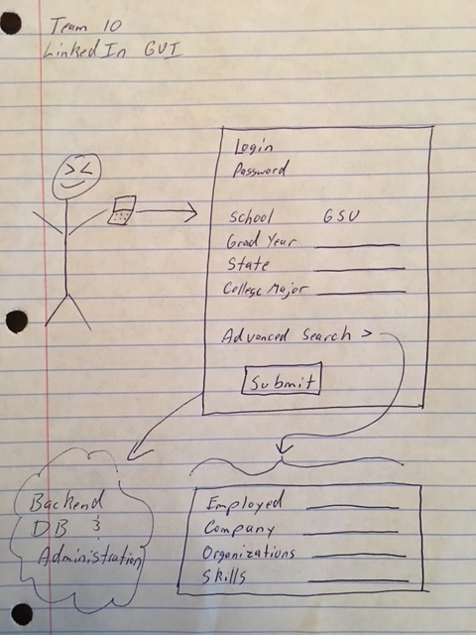
Conceptual Model
We are responsible for the user interface
The GUI should be uncluttered and straightforward to use
Most used search criteria will be visible from the main screen
Less used search criteria will be visible through a collapsible Advanced Search area
All collected data will be gathered and sent to the server team for processing

Slide 5
Projected Risks
Failed Logins: To notify user of failed login, a notification will need to be sent back to the user interface from the server. Thus there is a dependency on GUI controller completeness on the server team as they will need to call an error construct on the UI.
Query Results Notification: Once the query has completed, a notification should be sent to the GUI. Since we are creating a CSV, we also need to let the user know where to access the file. Thus there is a bidirectional dependency between the GUI and the Administration teams.

Slide 6
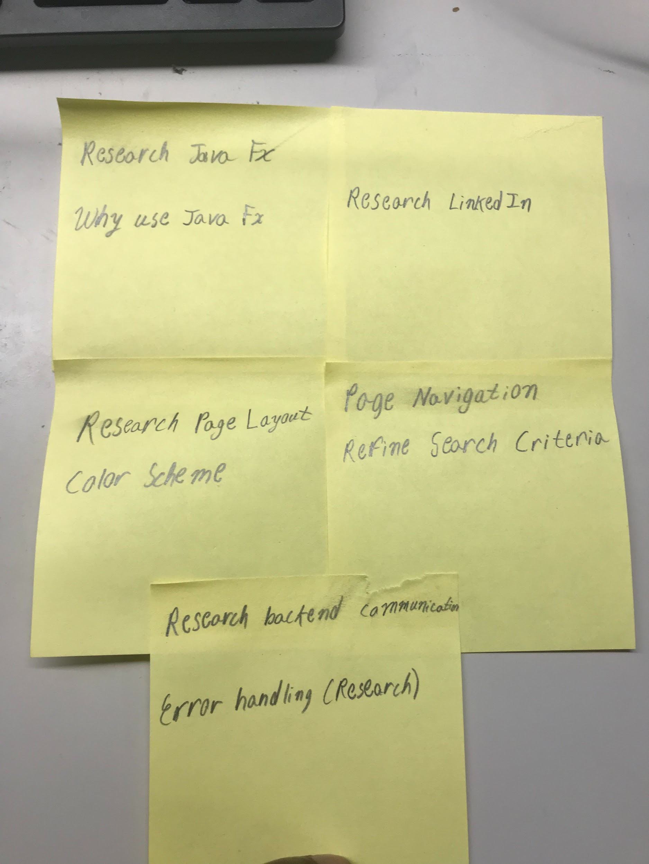
The Sprint Backlog
Research Java FX and why would we use Java FX
Research Page Layout and also the color scheme
We will look at how our page is navigated and refine our search criteria
Research on how to communicate with our backend and research on how to handle error that occur
Research LinkedIn

Slide 7
The Features
As a Job Recruiter, I want to search for profiles based on a few fields (college major, grad year, location) so I can find others I might want to connect with.
As a student I want to find a few of my past organization members that graduated last year
As an employee for a large corporation and I want to find other people who share my same skills
As the head of HR, I want to find a candidate that possess a certain skill
As a developer, I can create and edit the application with ease of development

Slide 8
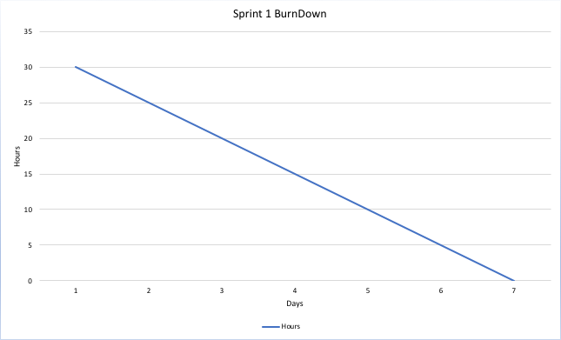
Sprint BurnDown
The Sprint Burndown Report shows the progress within the Sprint toward reaching the Sprint Goal. It allows easy estimation if the Sprint Goal can be reached in time or if the team has to find additional measures to speed-up completion of the remaining activities.

